Slide 1

A PROJECT ON
“ROYALSHELL RESORT SYSTEM”
Institute for Advanced Computing & Software Development
Akurdi
SUBMITTED BY:
MS. JANHAVI GOVIND SHINDE
MR. SACHIN VISHNU SANGDE

Slide 2
Introduction
Royalshell resort system project introduces a digital solution to streamline and enhance the resort reservation process. This platform offers customers the convenience of browsing, selecting, and booking resort accommodations and amenities online. By eliminating the need for traditional booking methods, the project aims to improve customer satisfaction and operational efficiency.
Through a user-friendly interface, guests can access real-time availability and make secure reservations, ushering in a new era of seamless and efficient resort booking experiences.

Slide 3
Technology Used
We used Java Spring-Boot as backend and React JS as Frontend in our Project.
Spring-Boot :–
The main goal of the Spring Boot framework is to reduce overall development time and increase efficiency. React has become the first choice for frontend because it gives developers the ability to work with a virtual browser (more friendly than the real browser). Also, a JavaScript developer can become a productive developer in a few hours because there is a small API to learn, a few functions, and how to use them…
React :–
React allows developers to create large web applications that can change data, without reloading the page. The main purpose of React is to be fast, scalable, and simple. Spring

Slide 4
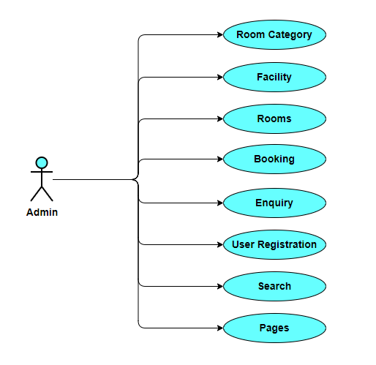
Use Case diagram for Admin

Slide 5
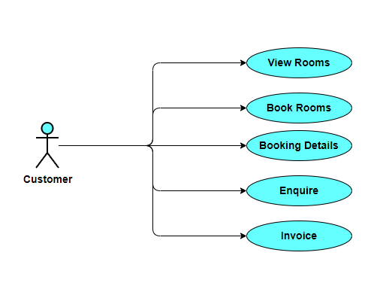
Use Case diagram for Customer

Slide 6
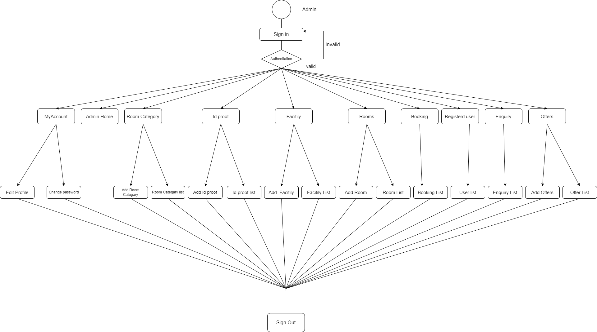
Activity Diagram : Admin

Slide 7
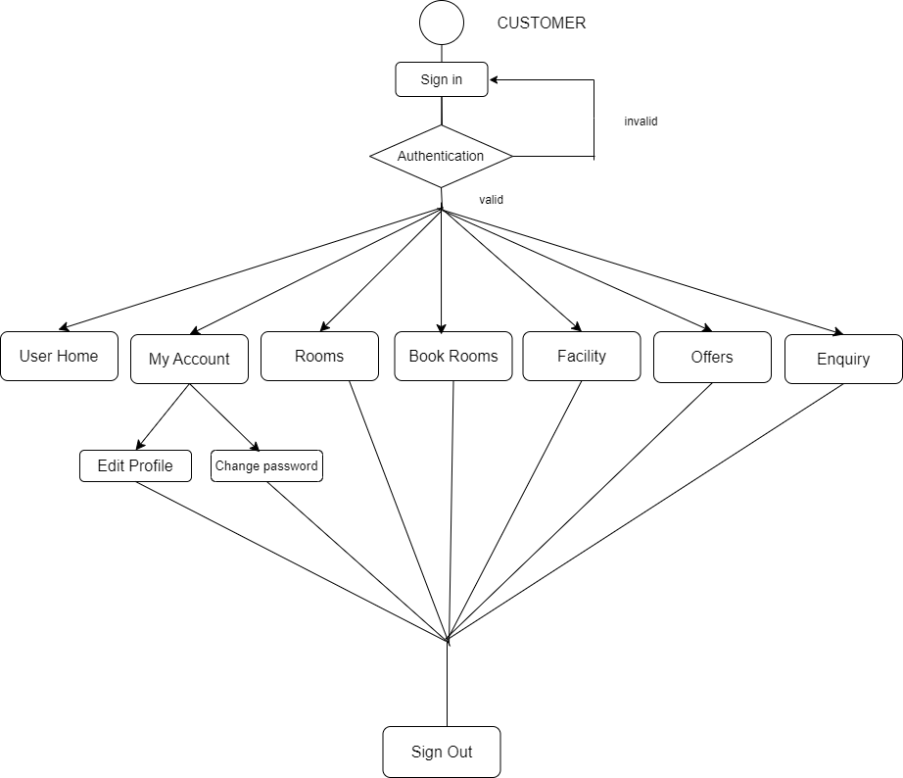
Activity Diagram : Admin

Slide 8
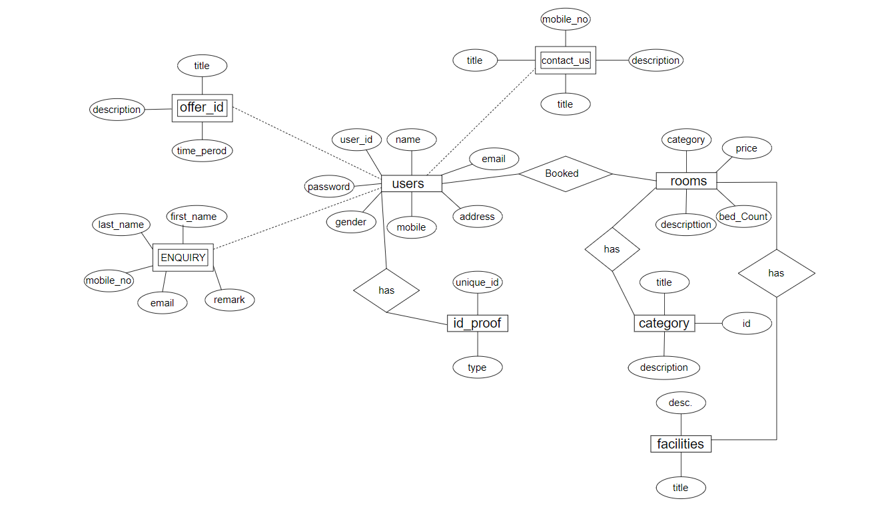
ER Diagram

Slide 9
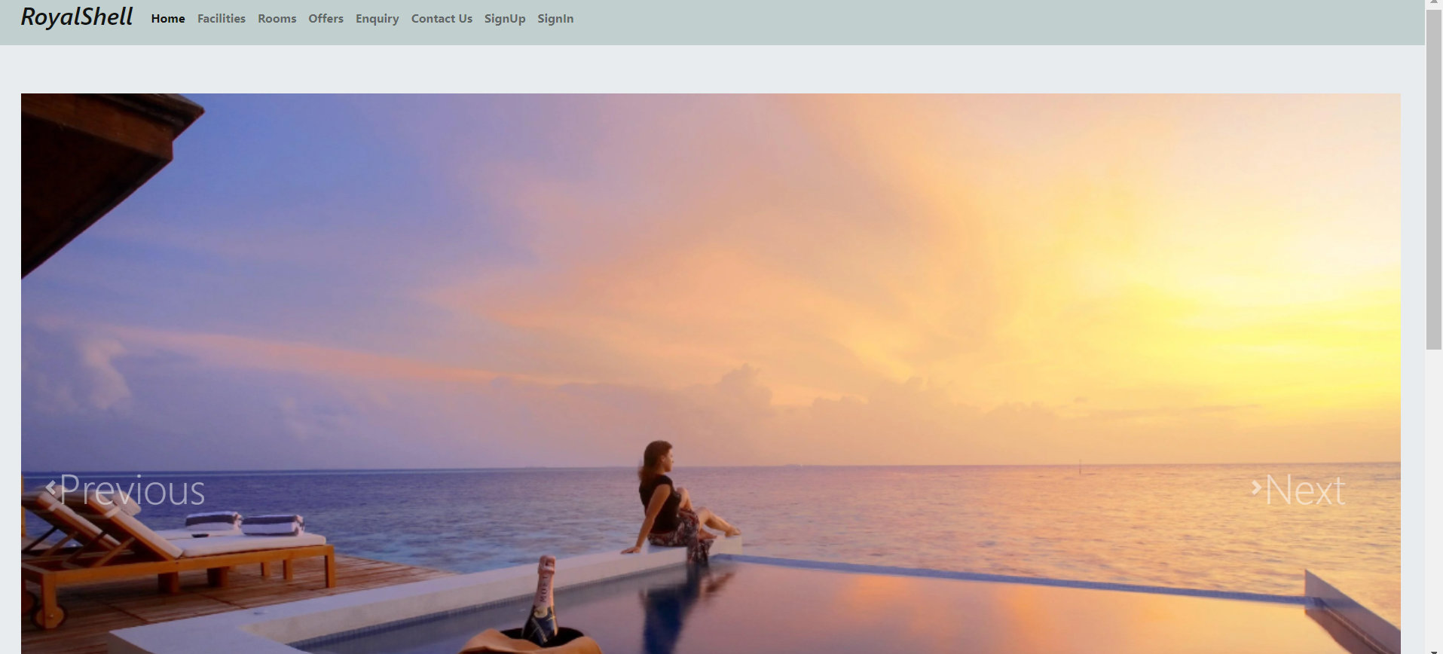
Home Page:

Slide 10
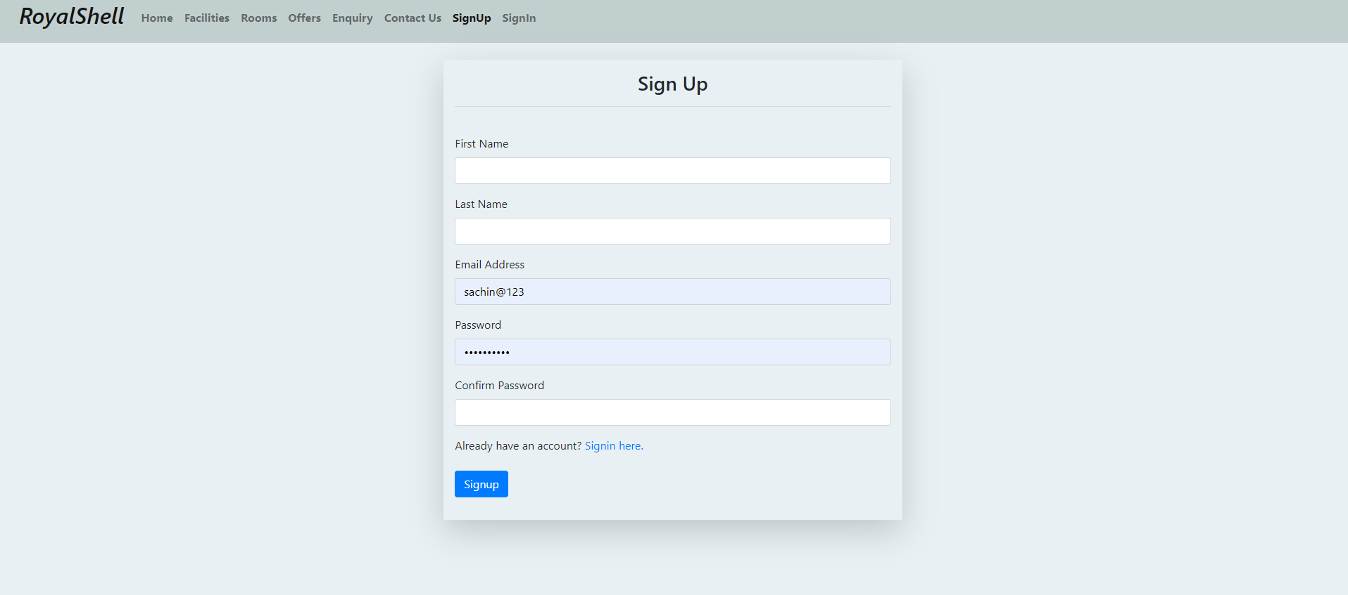
SignUp:

Slide 11
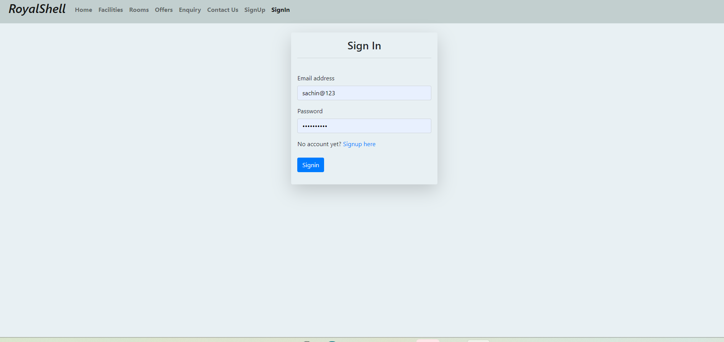
SignIn:

Slide 12
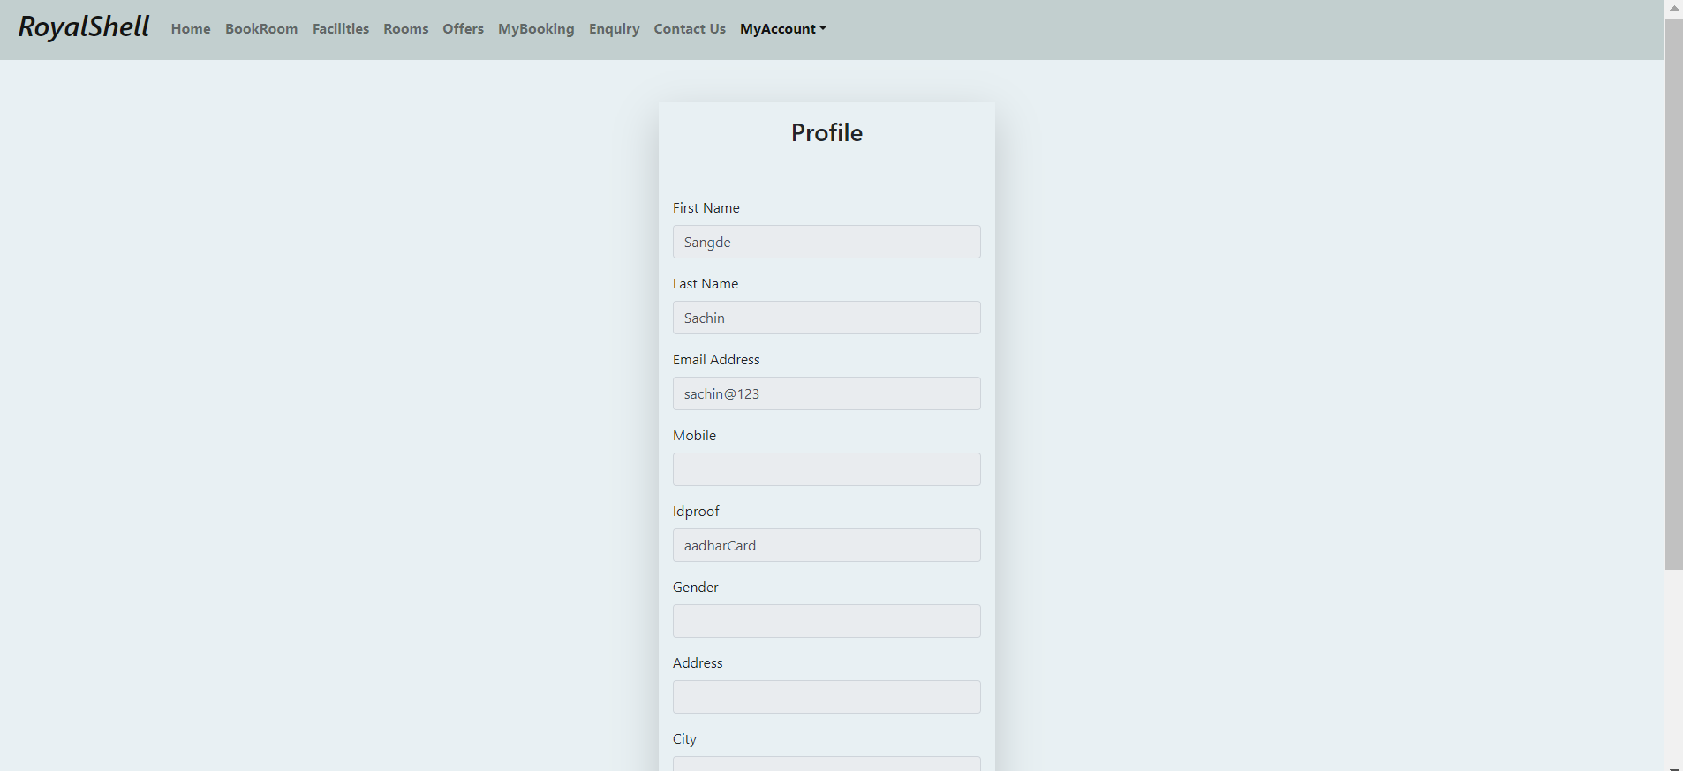
Edit Profile:

Slide 13
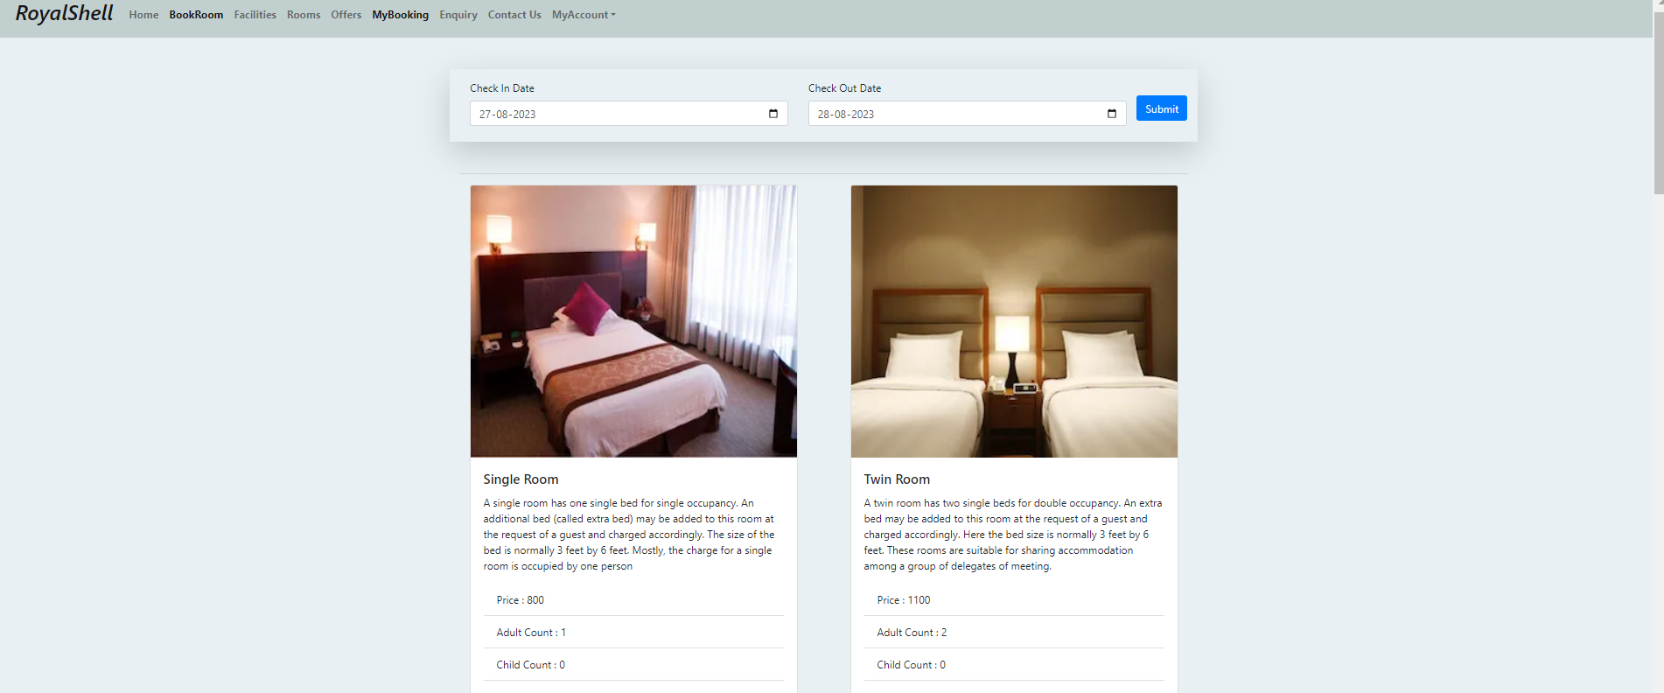
Rooms:

Slide 14
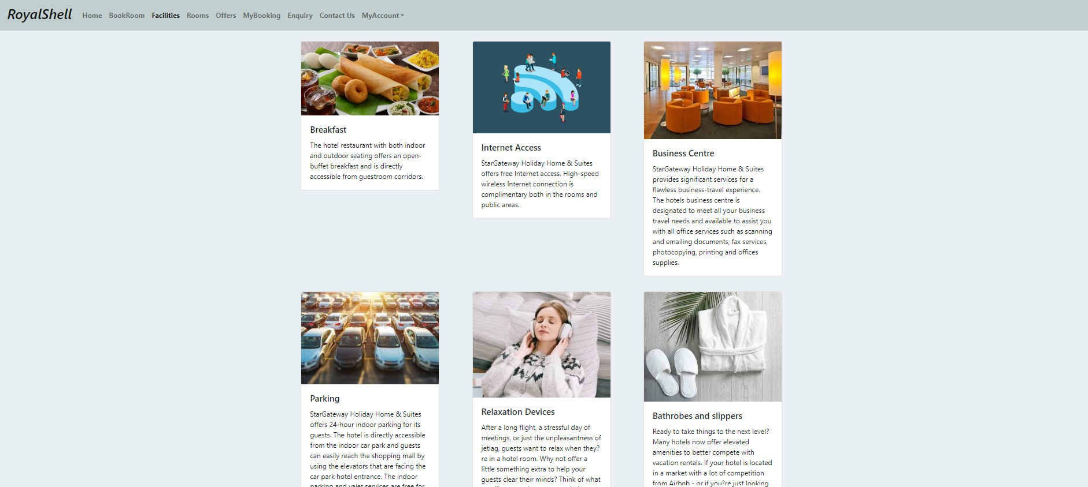
Facility:

Slide 15
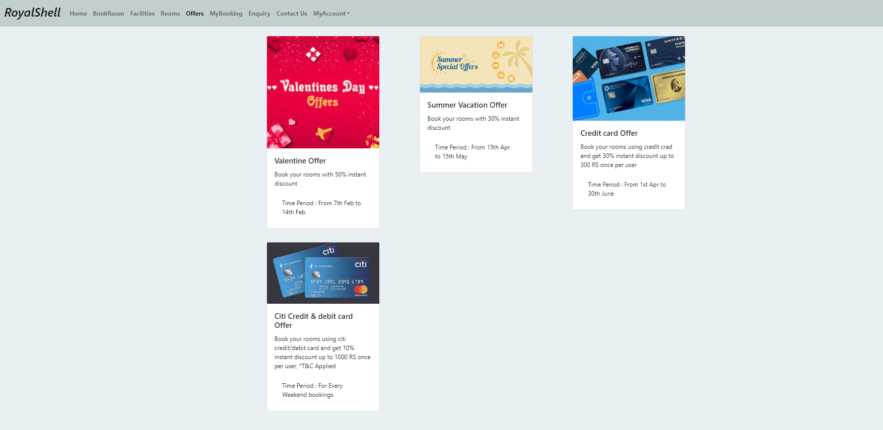
Offers

Slide 16
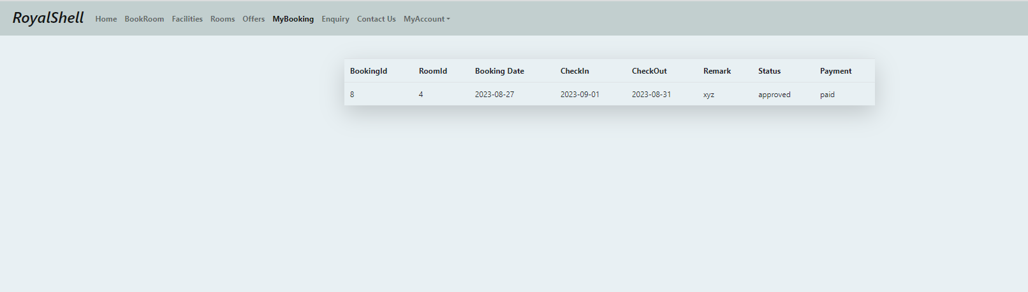
My Booking:

Slide 17
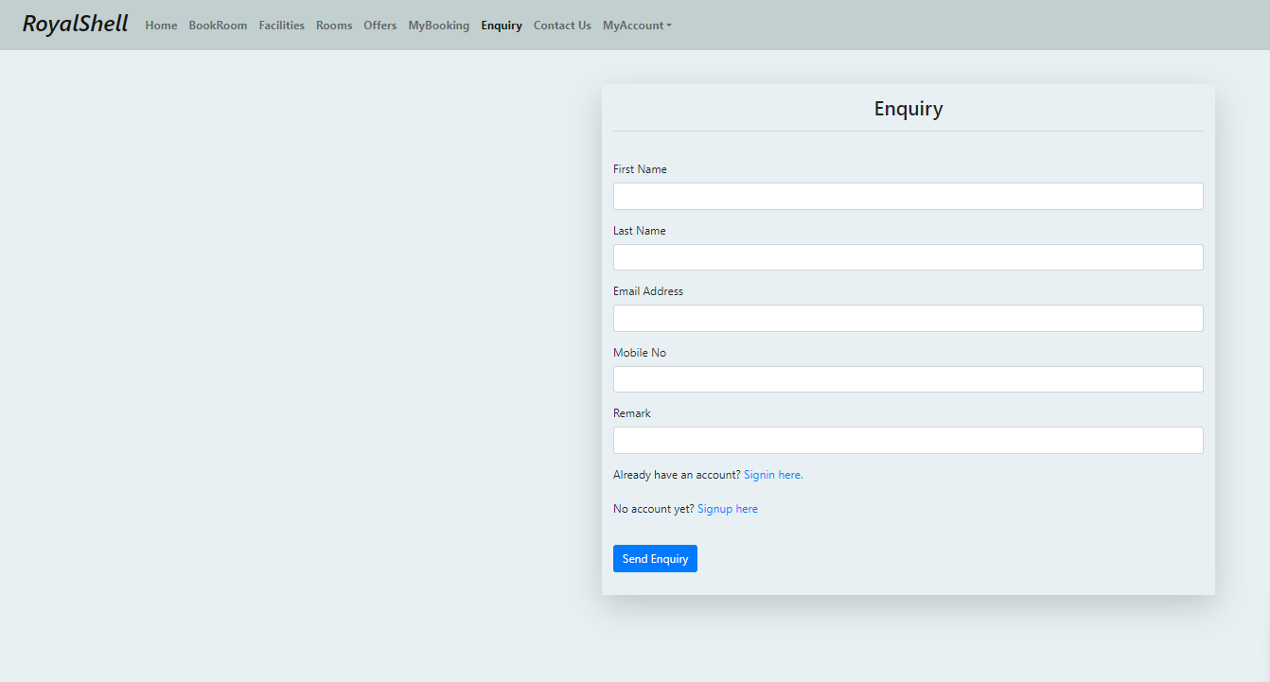
Enquiry

Slide 18
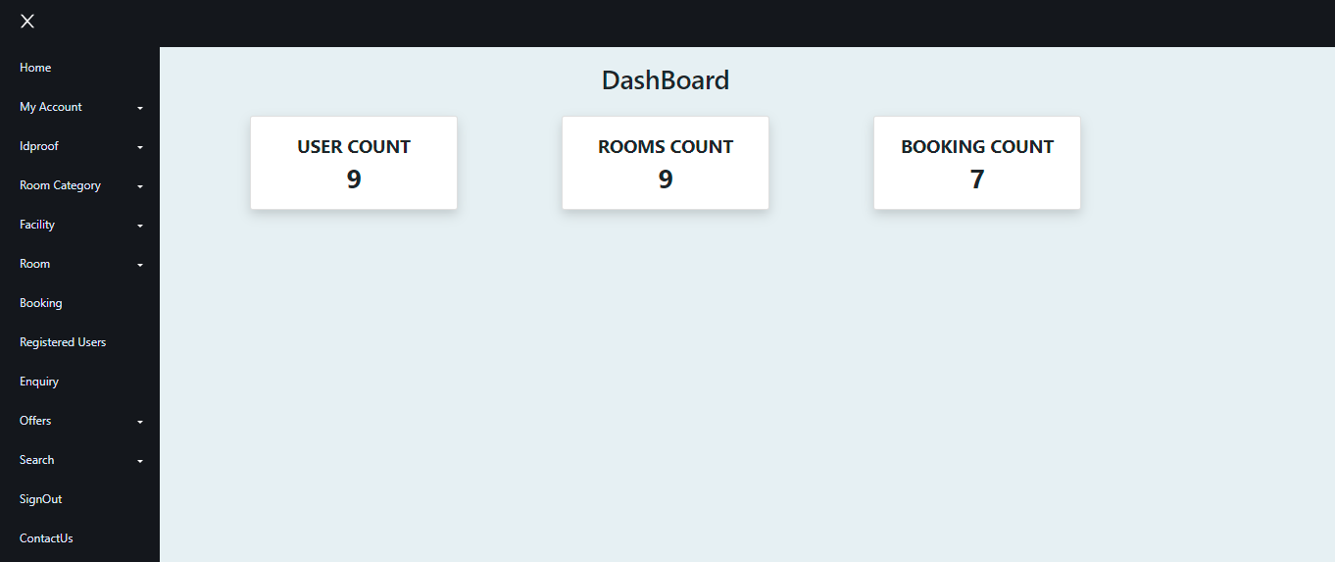
AdminHome:

Slide 19
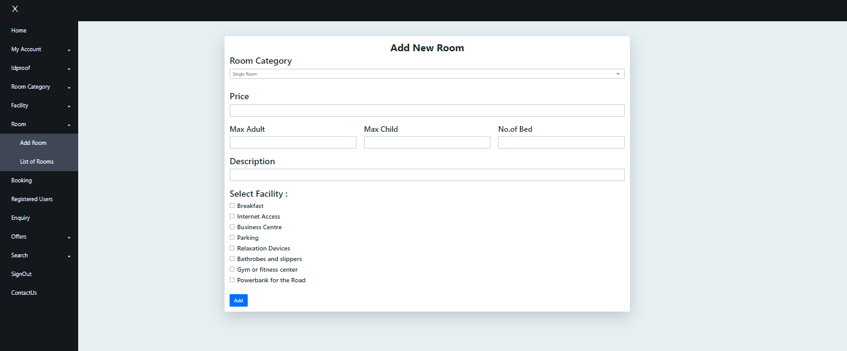
Add Room:

Slide 20
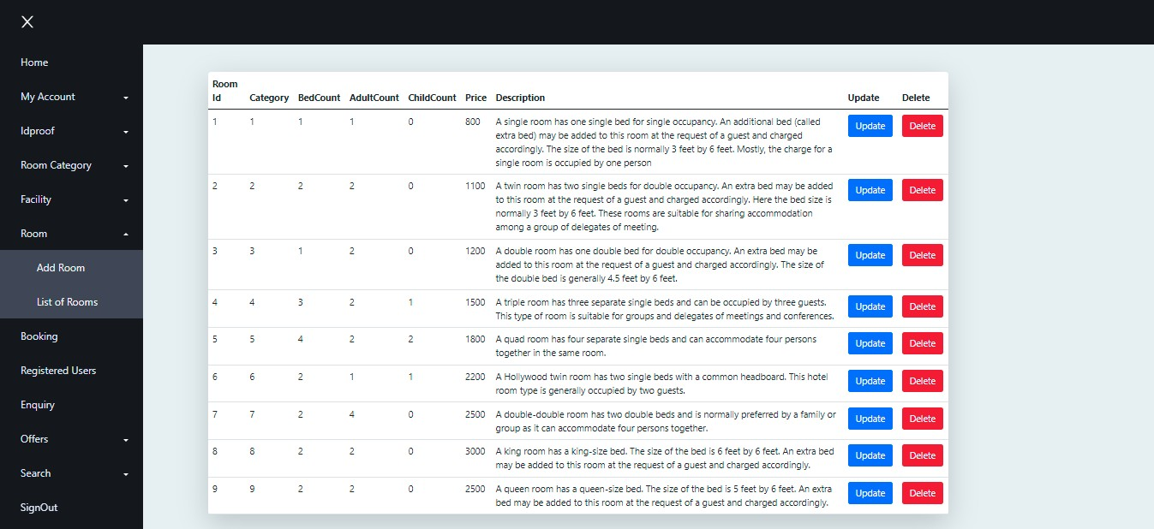
Room List:

Slide 21
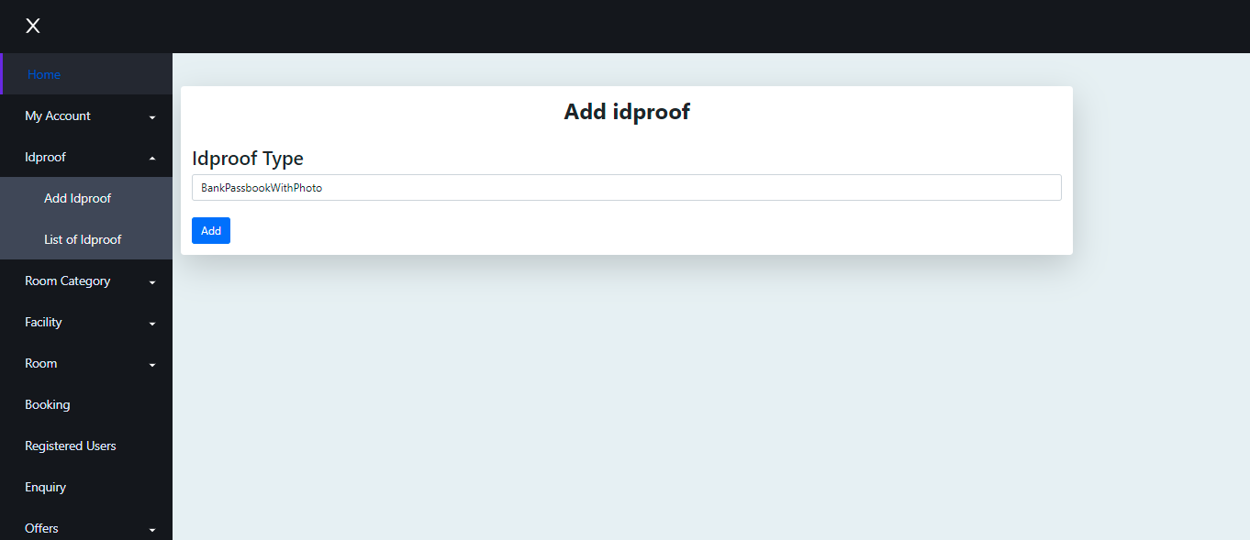
Idproof:

Slide 22
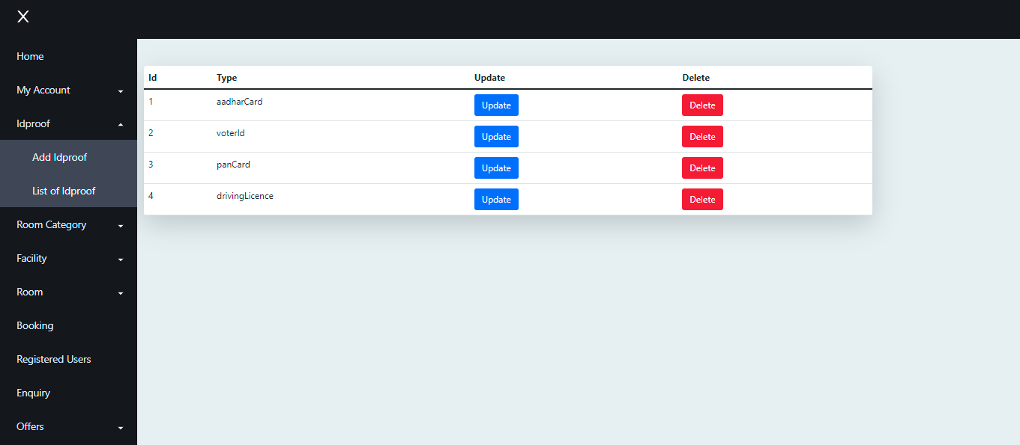
Idproof List:

Slide 23
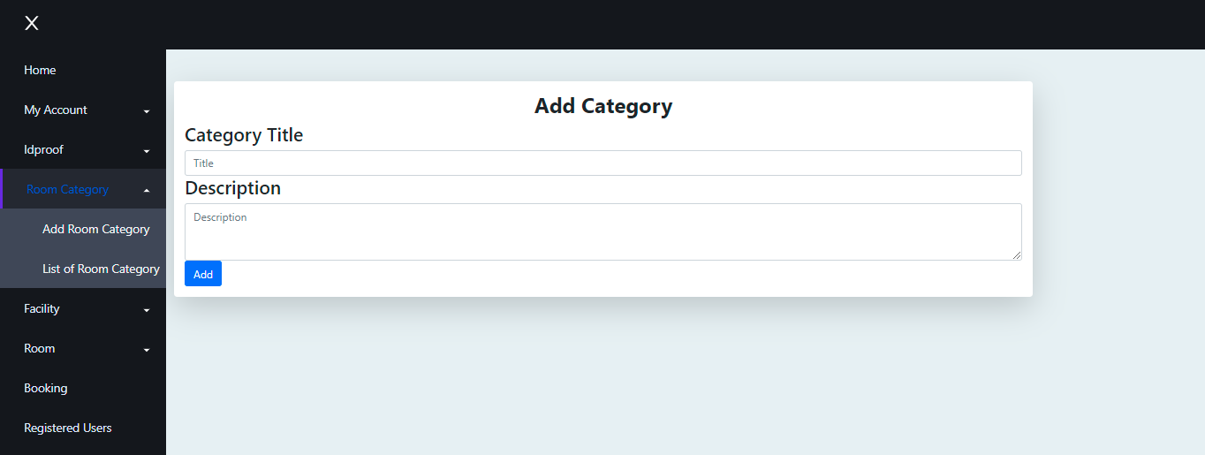
Add Room Category:

Slide 24
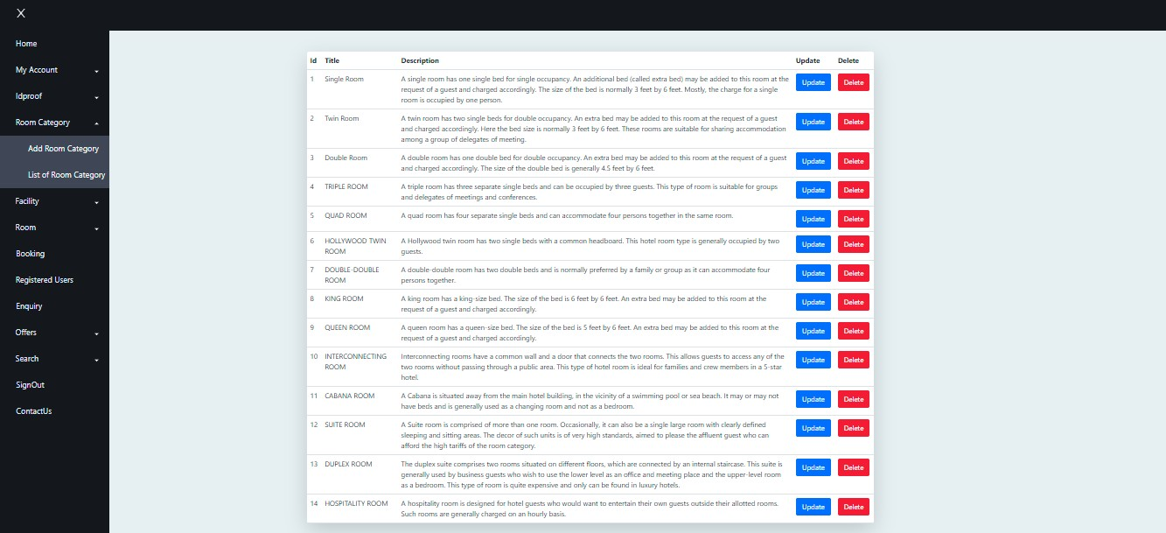
Room Category List:

Slide 25
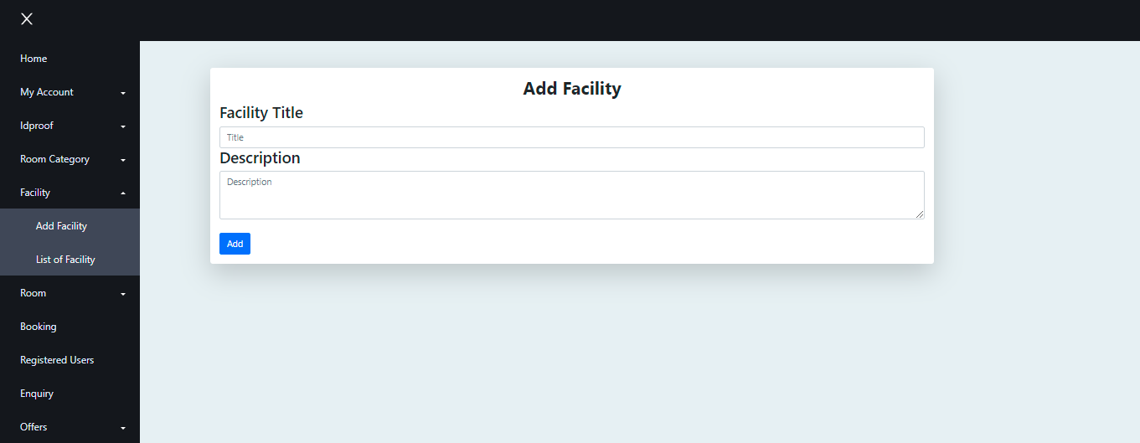
Add Facility:

Slide 26
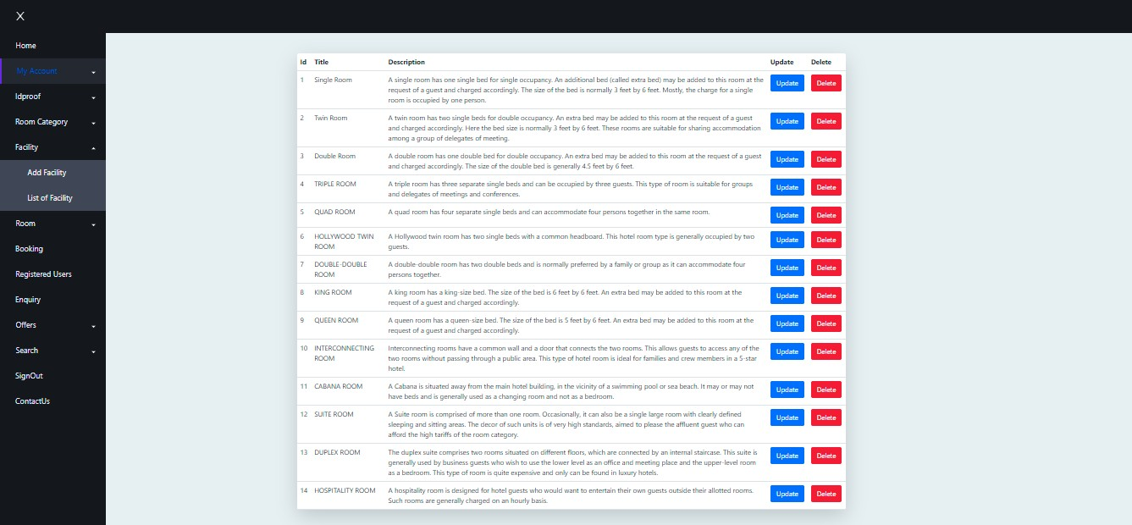
Facility List

Slide 27
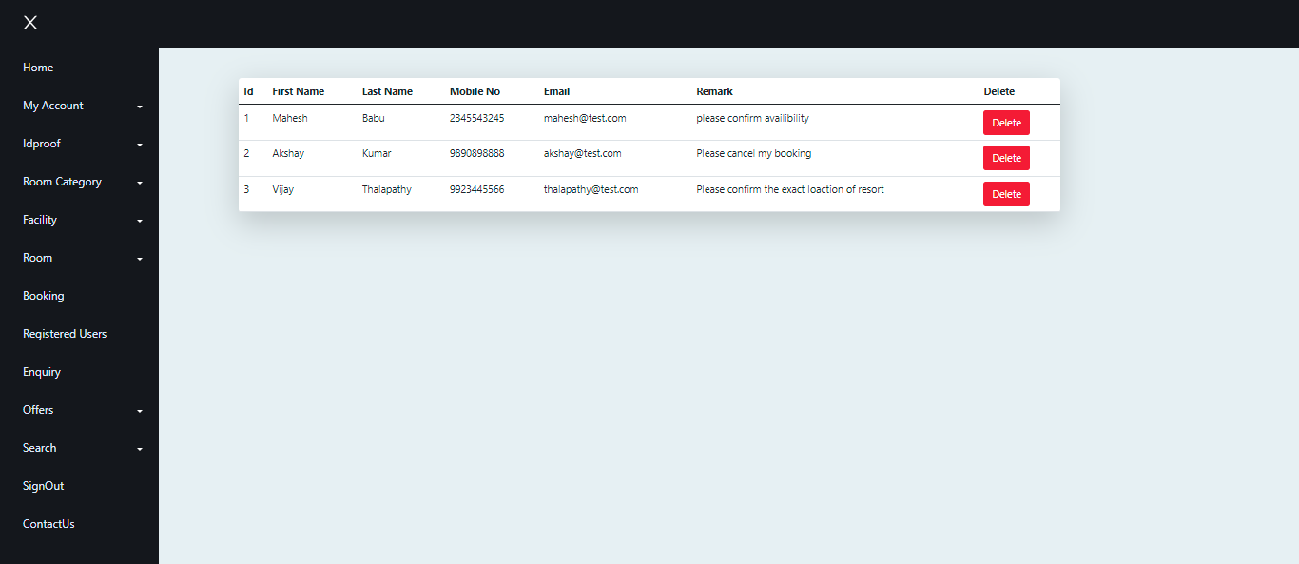
Enquiry List

Slide 28
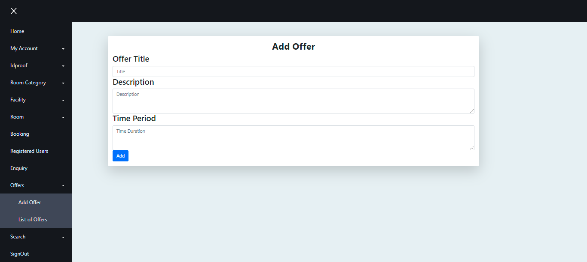
Add Offers

Slide 29
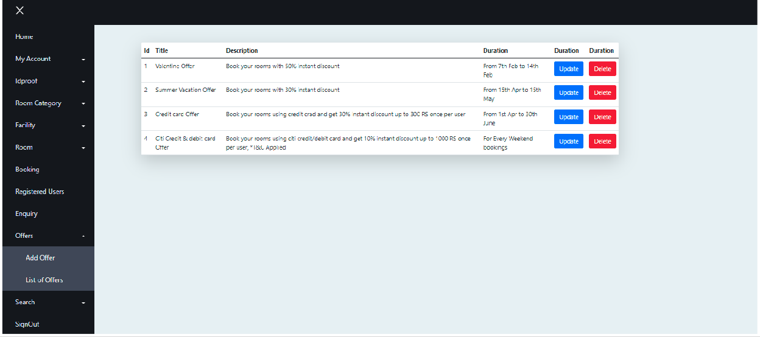
Offers List

Slide 30
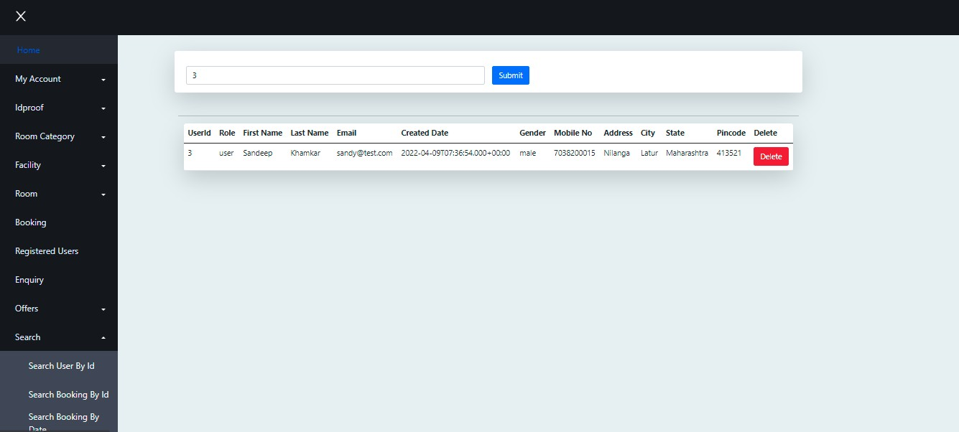
Search By User Id

Slide 31
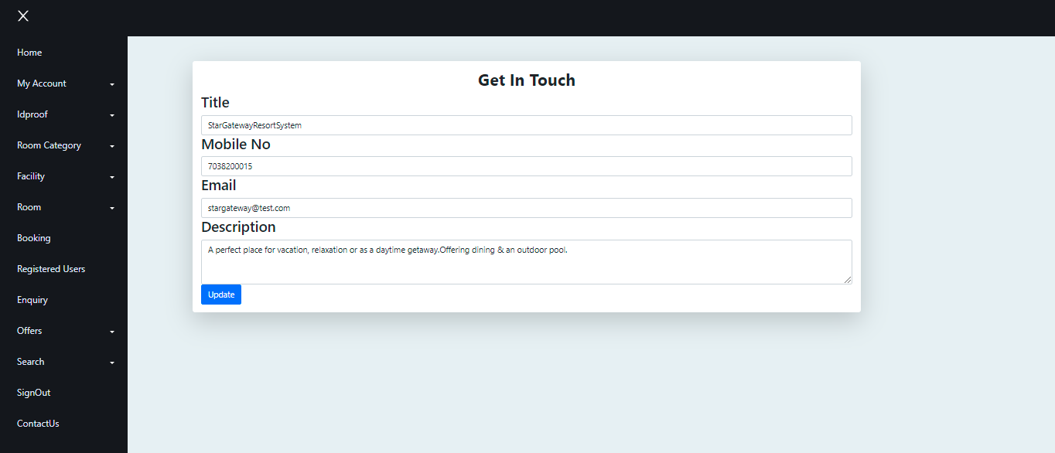
Contact Us

Slide 32
Git lab Link : https://gitlab.com/cdac_g24

Slide 33
Thanks

